Slide 1
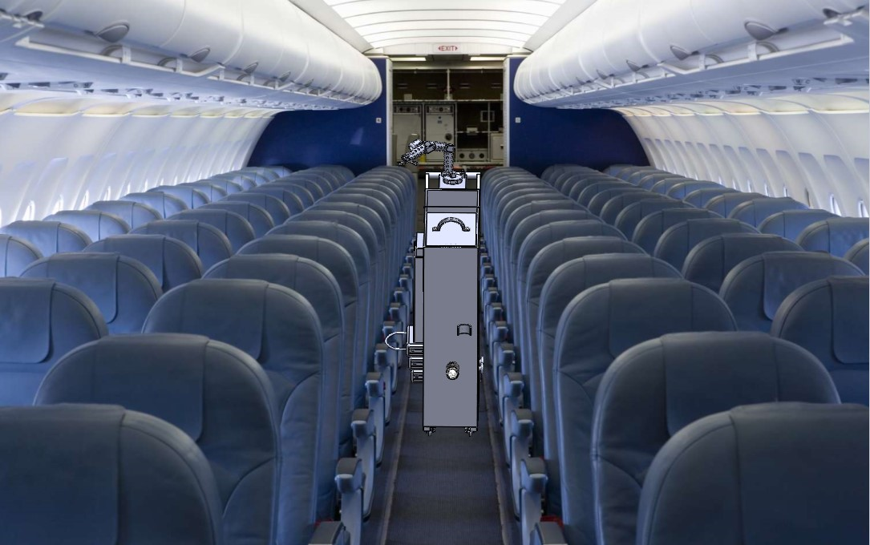
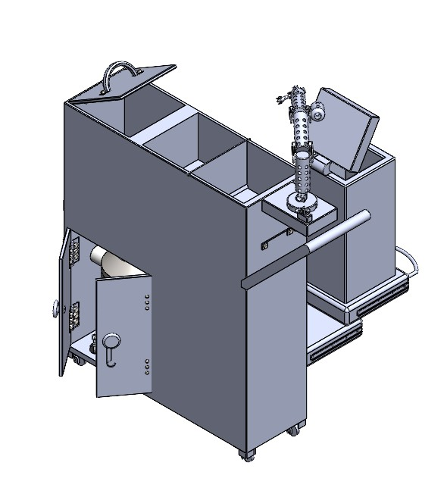
Travel Cart
ME 1670 - Section D
Yash Parmar
Bryant Harrison
Jackson Foster
Nishu Anekere
JB O’Neal
Instructor: Dr. Raghu Pucha TA: Gashaw Bizana

Slide 2
Outline
Part Models
Individual Member Parts
Assembly Models
Sub Assemblies
Final Assemblies
Challenges
Rendered Views
Final Animation

Slide 3
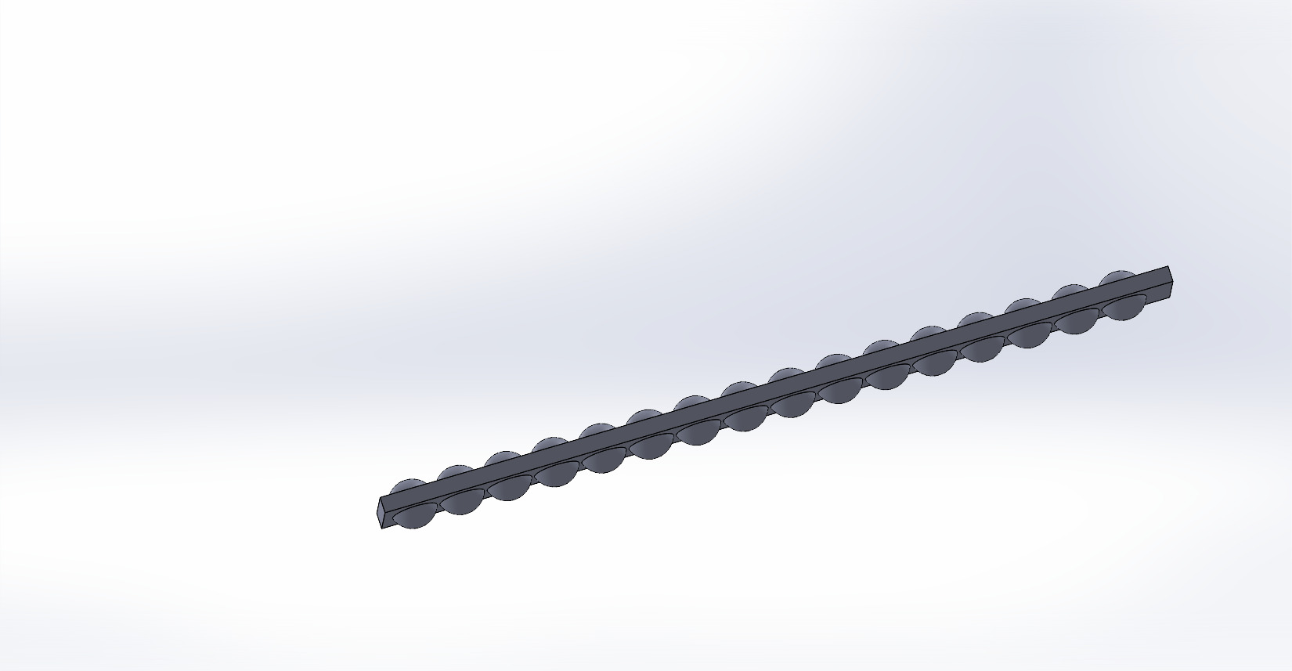
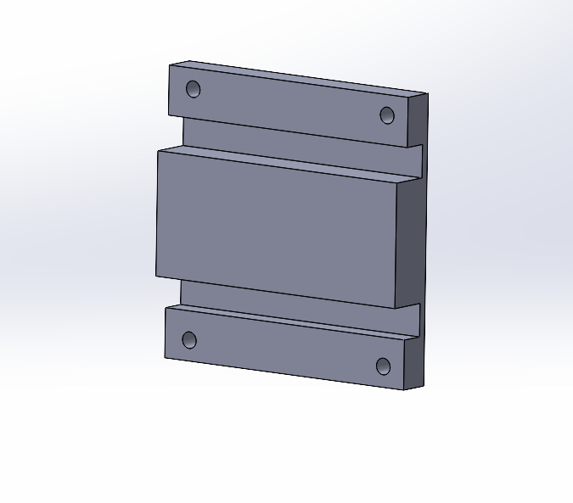
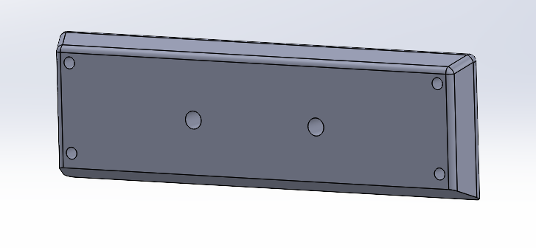
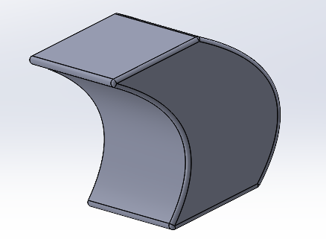
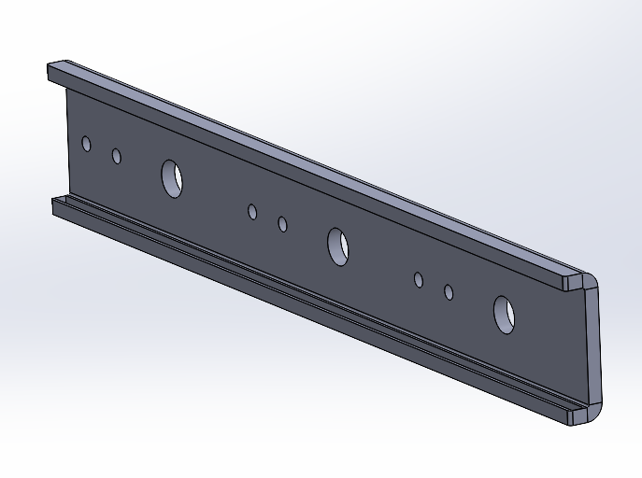
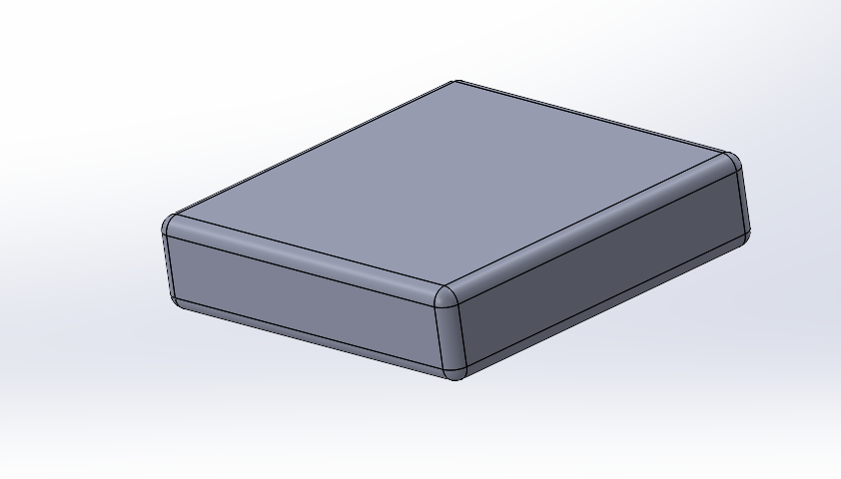
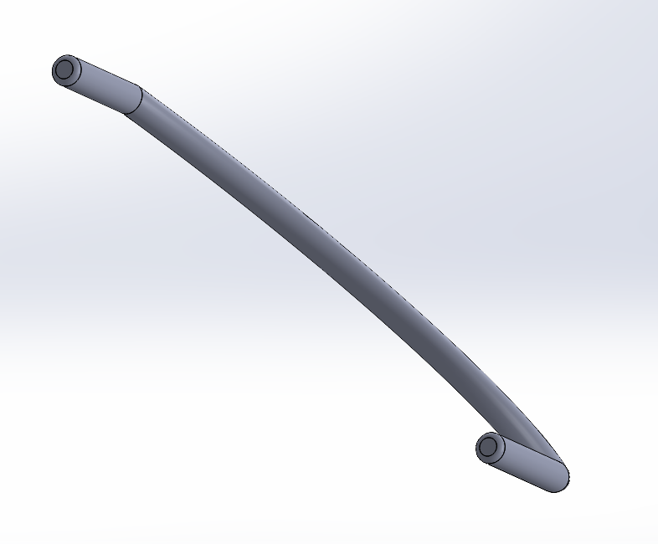
Yash Parmar Parts

Slide 4
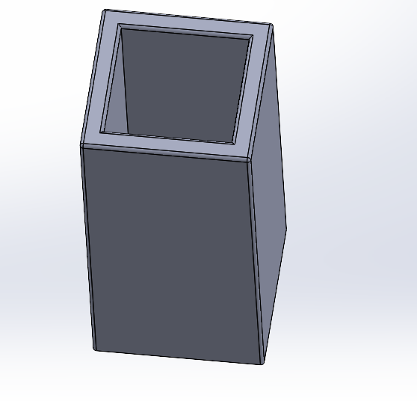
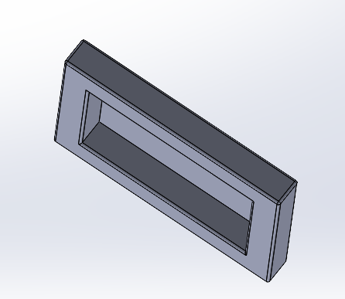
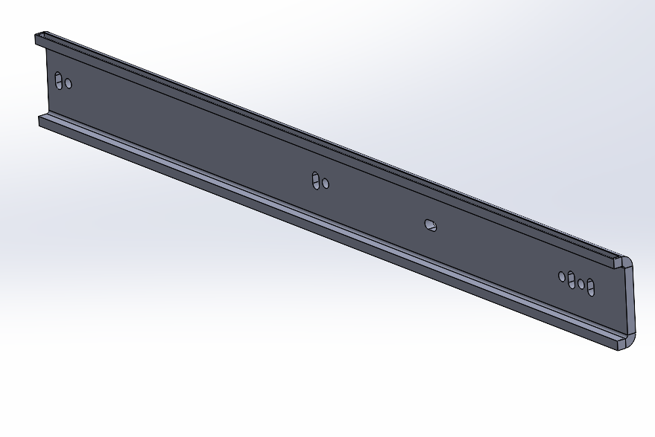
Yash Parmar Parts

Slide 5
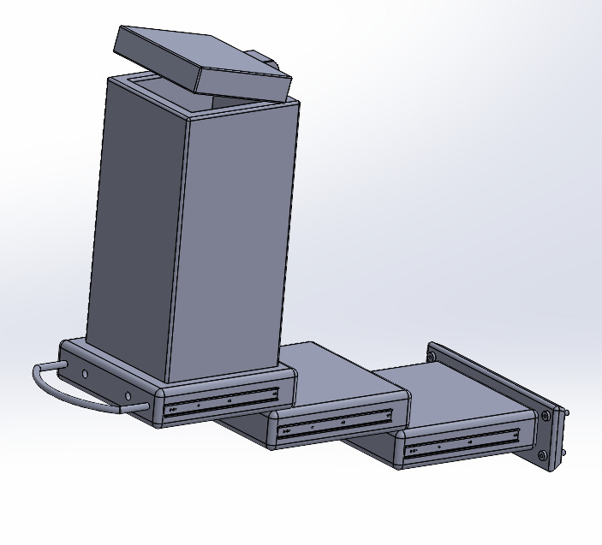
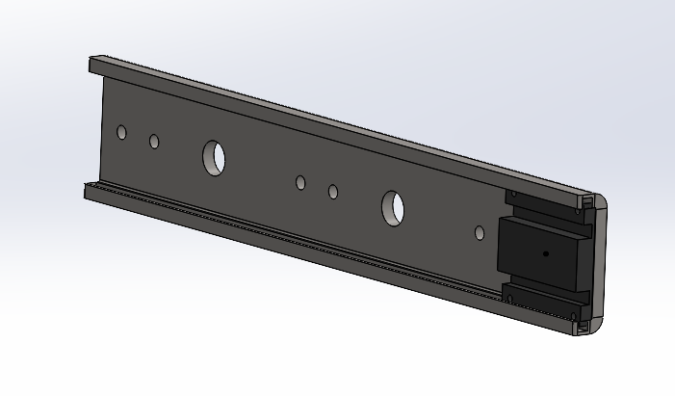
Yash Parmar Sub-Assemblies

Slide 6
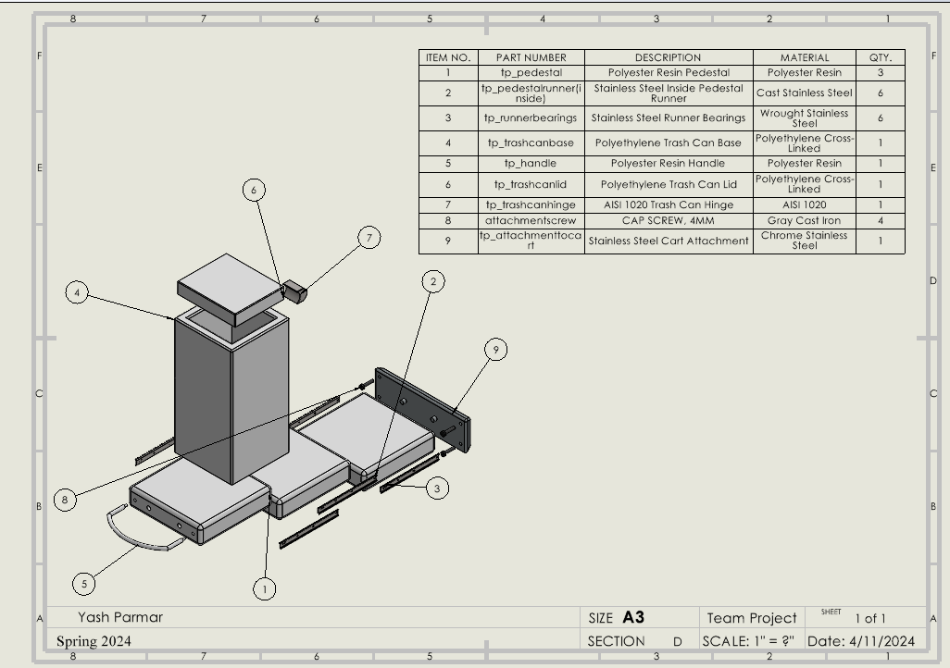
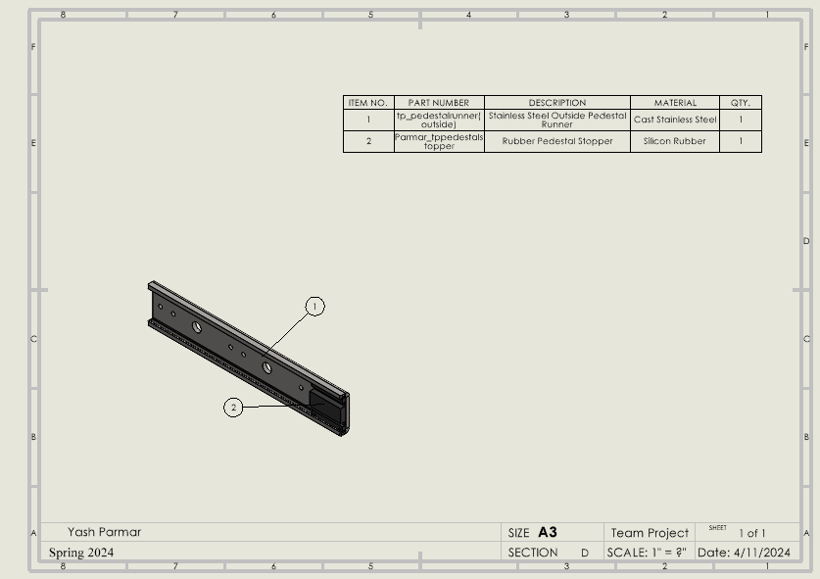
Yash Parmar Exploded Views

Slide 7
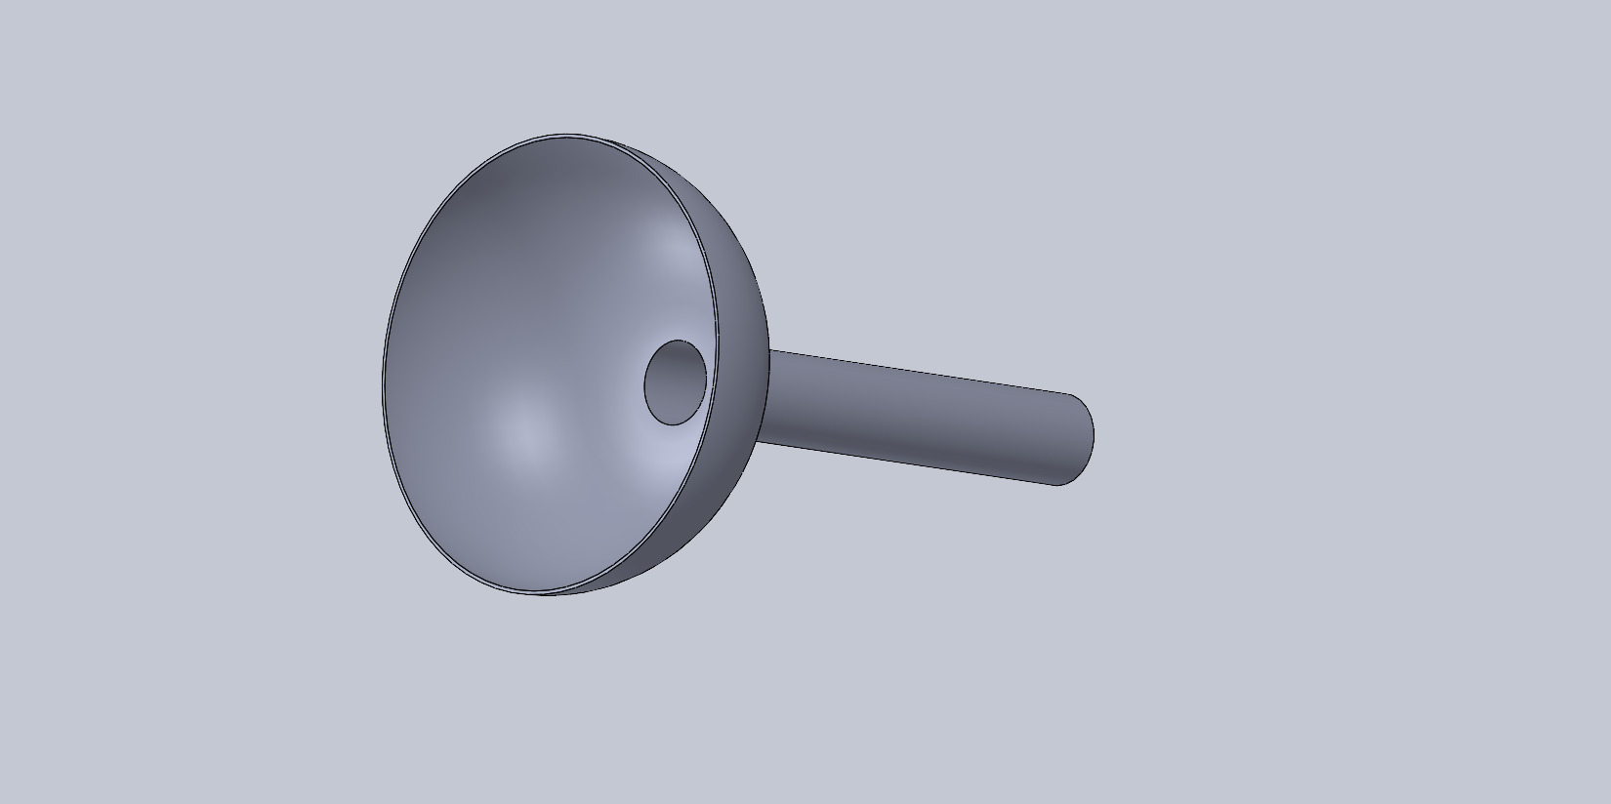
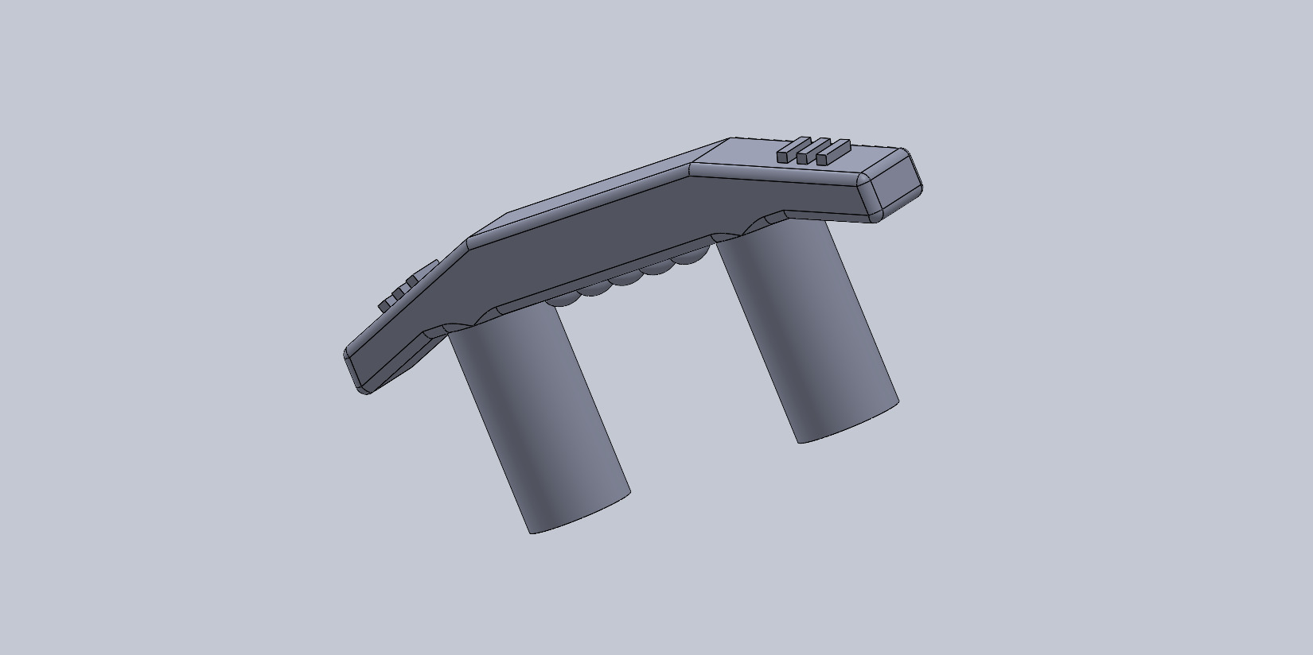
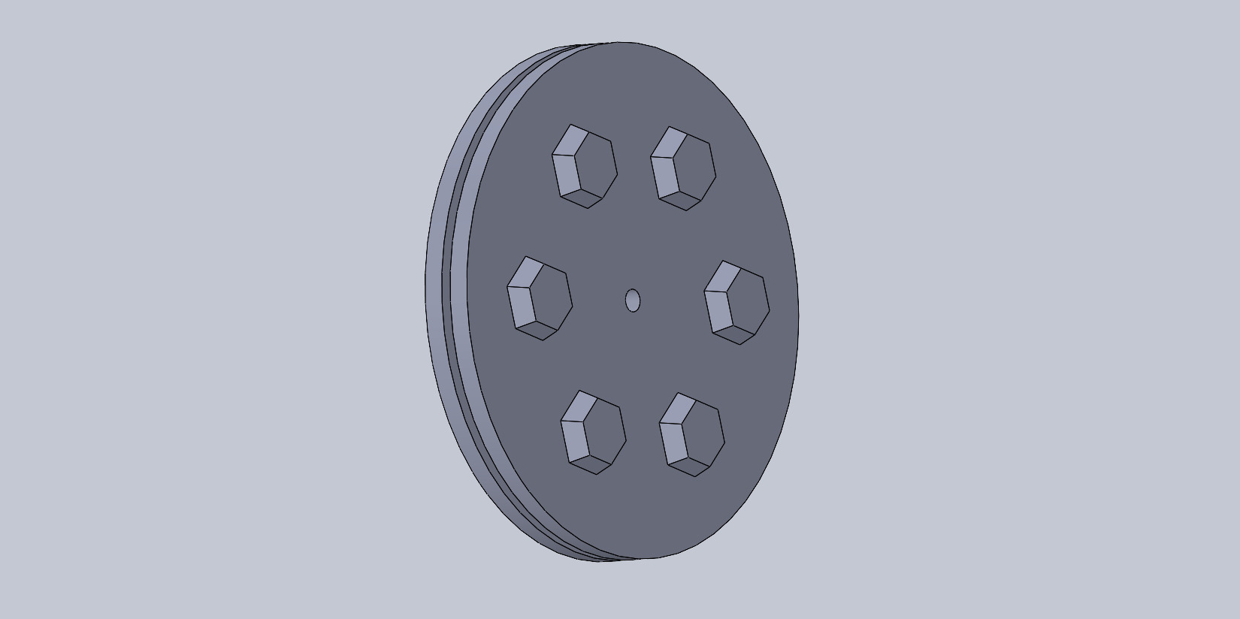
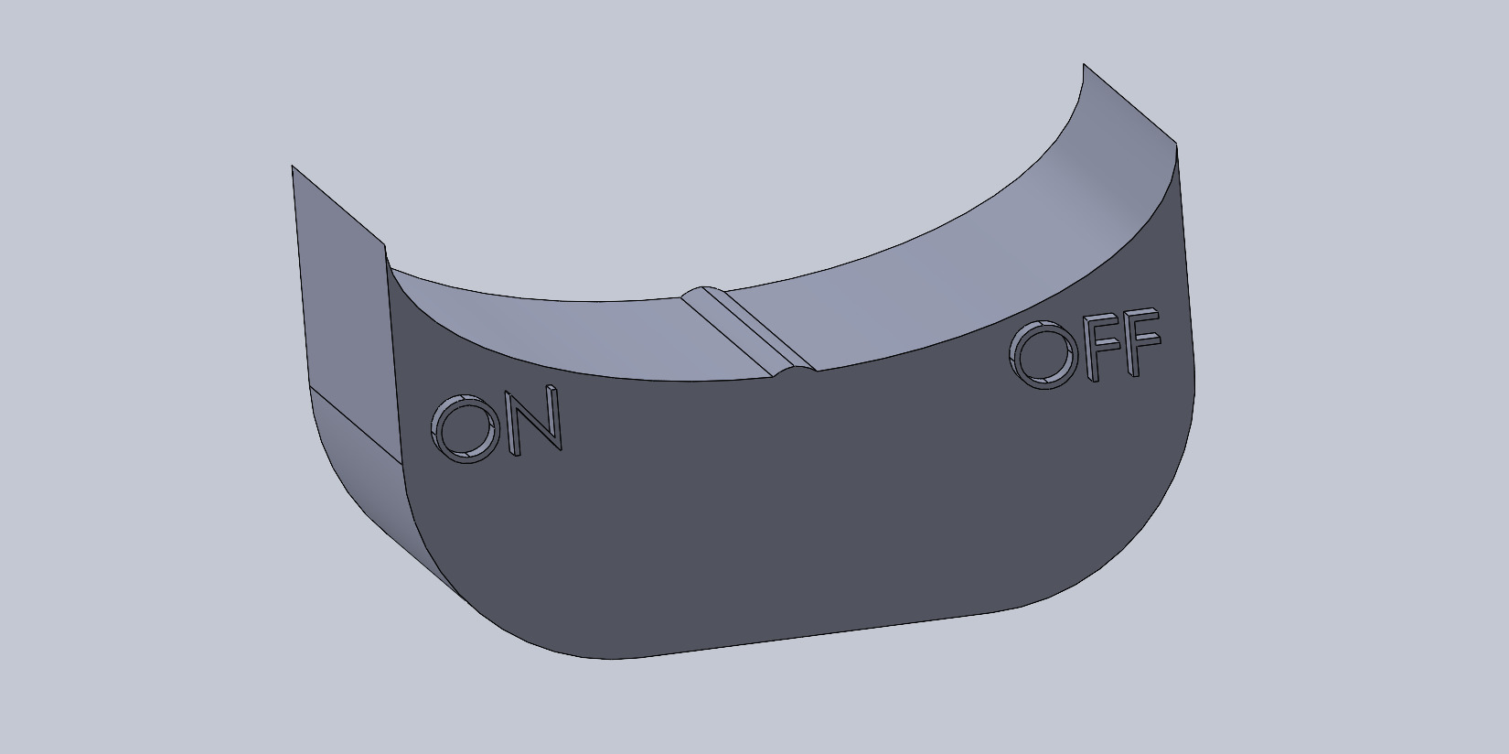
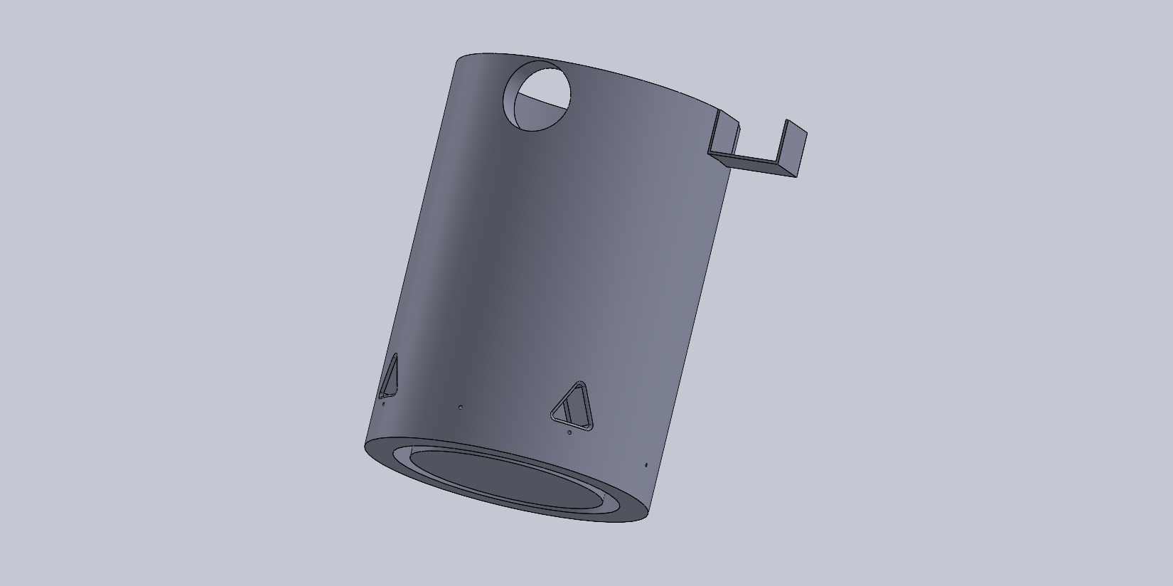
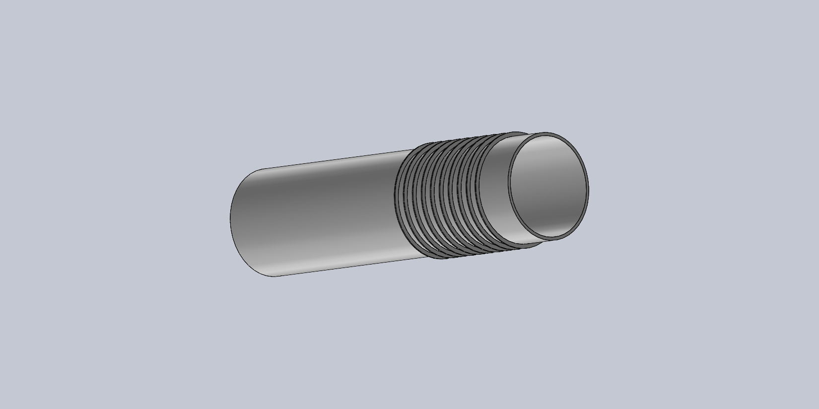
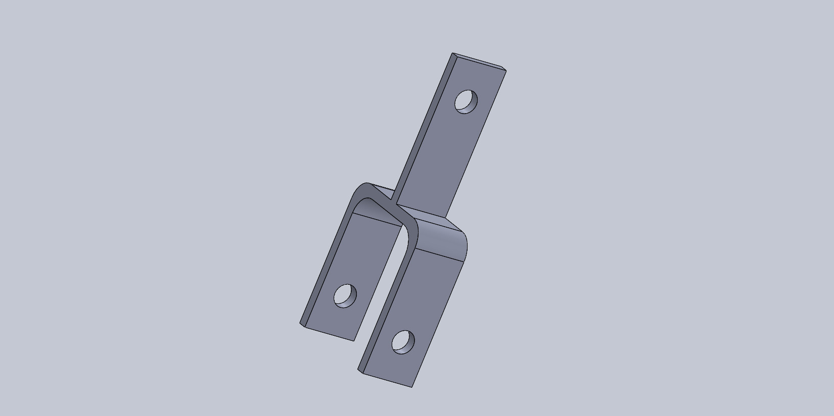
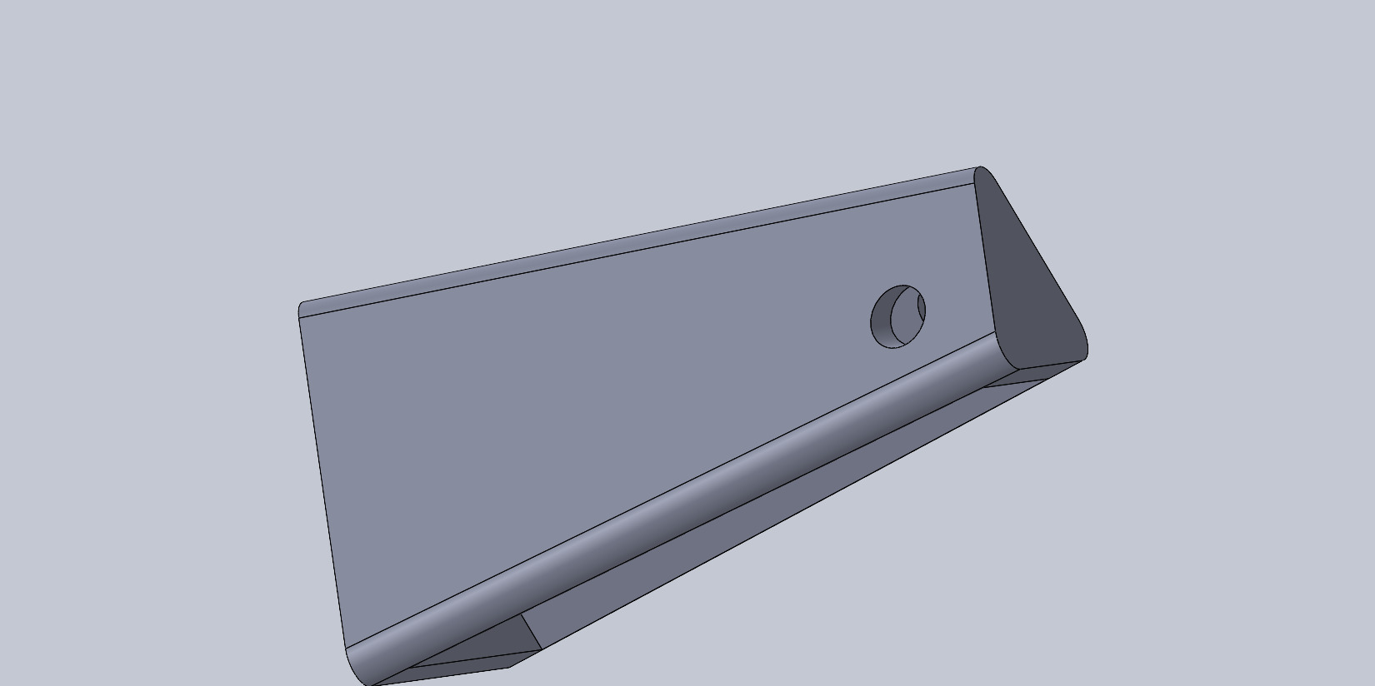
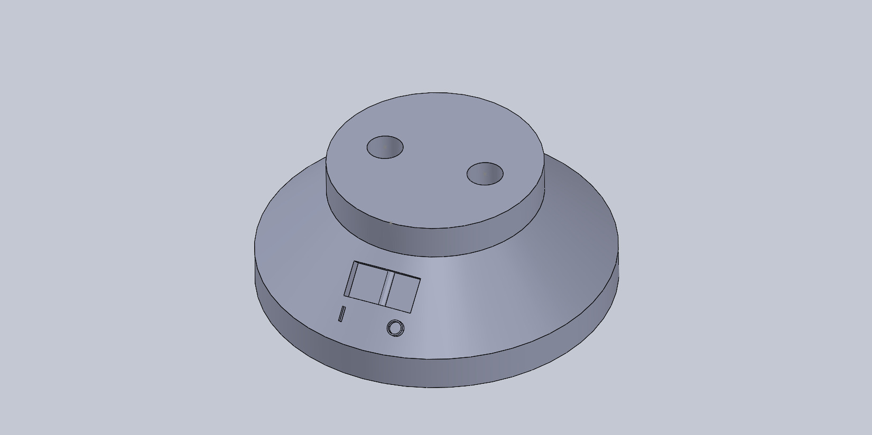
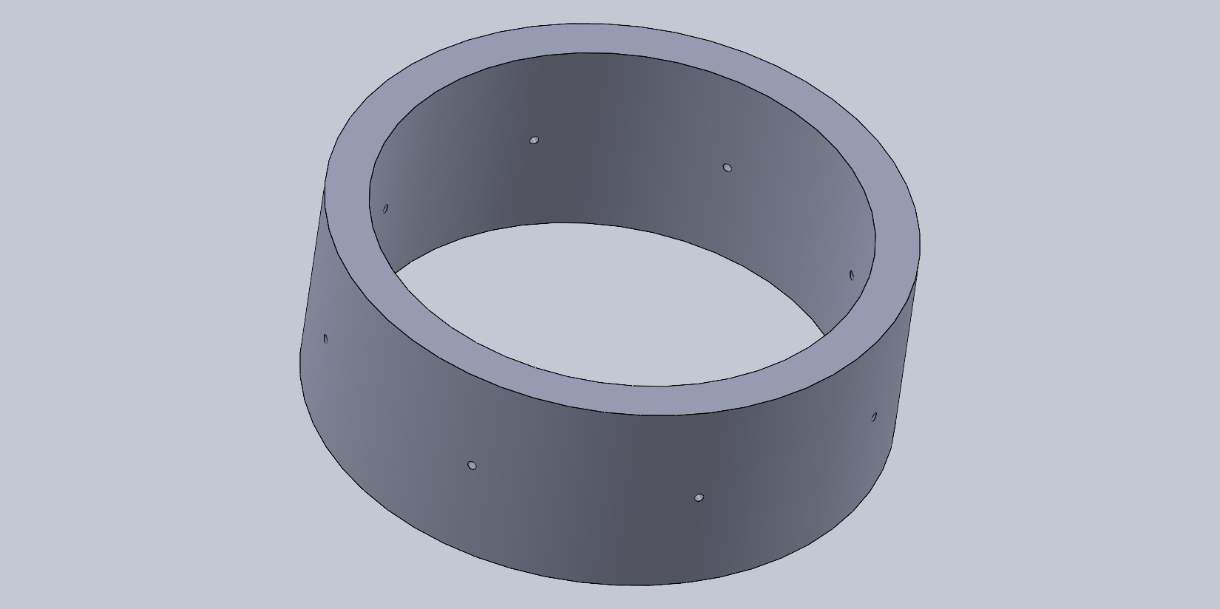
Bryant Harrison Parts

Slide 8
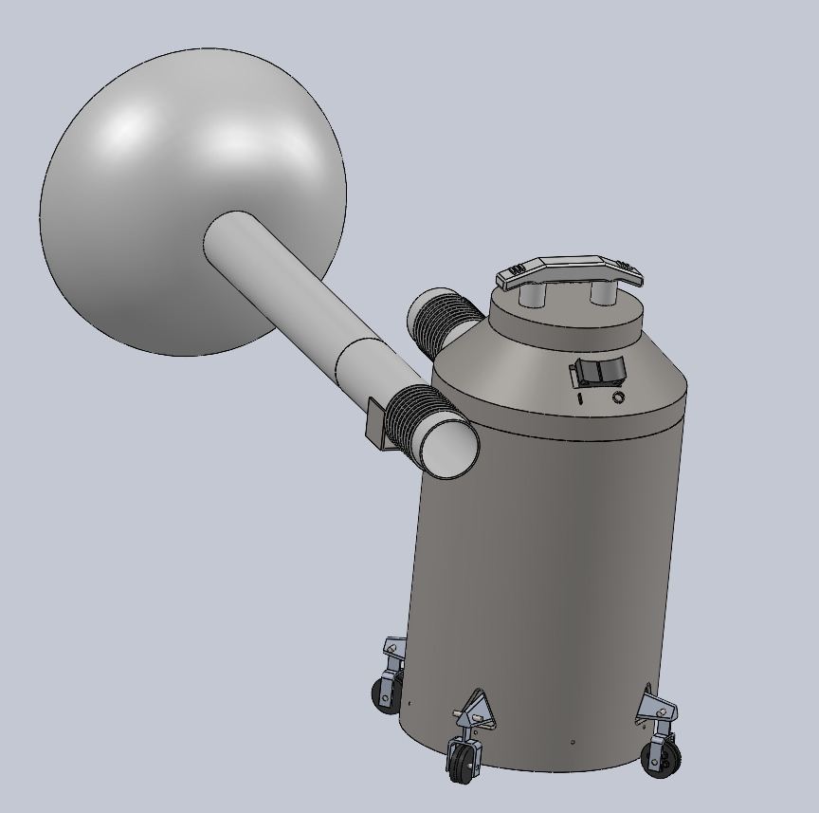
Bryant Harrison Sub-Assemblies

Slide 9
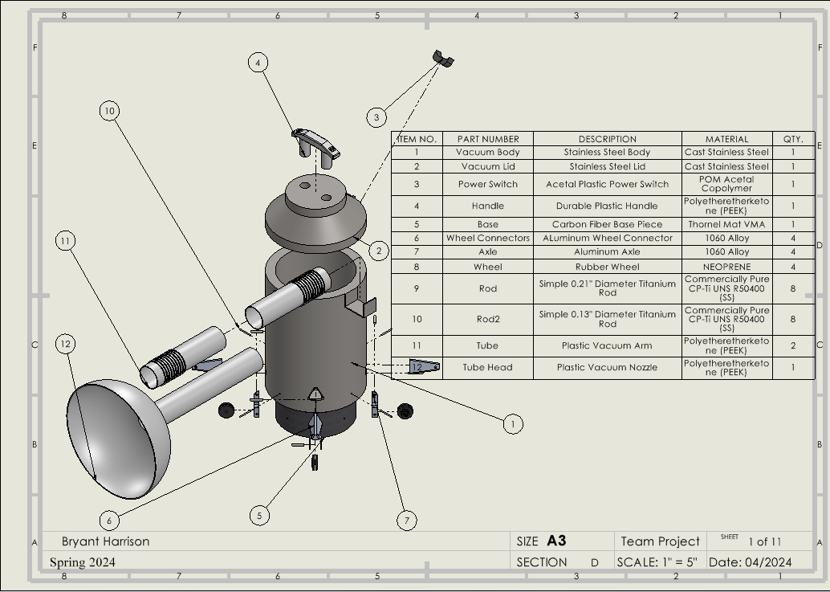
Bryant Harrison Exploded Views

Slide 10
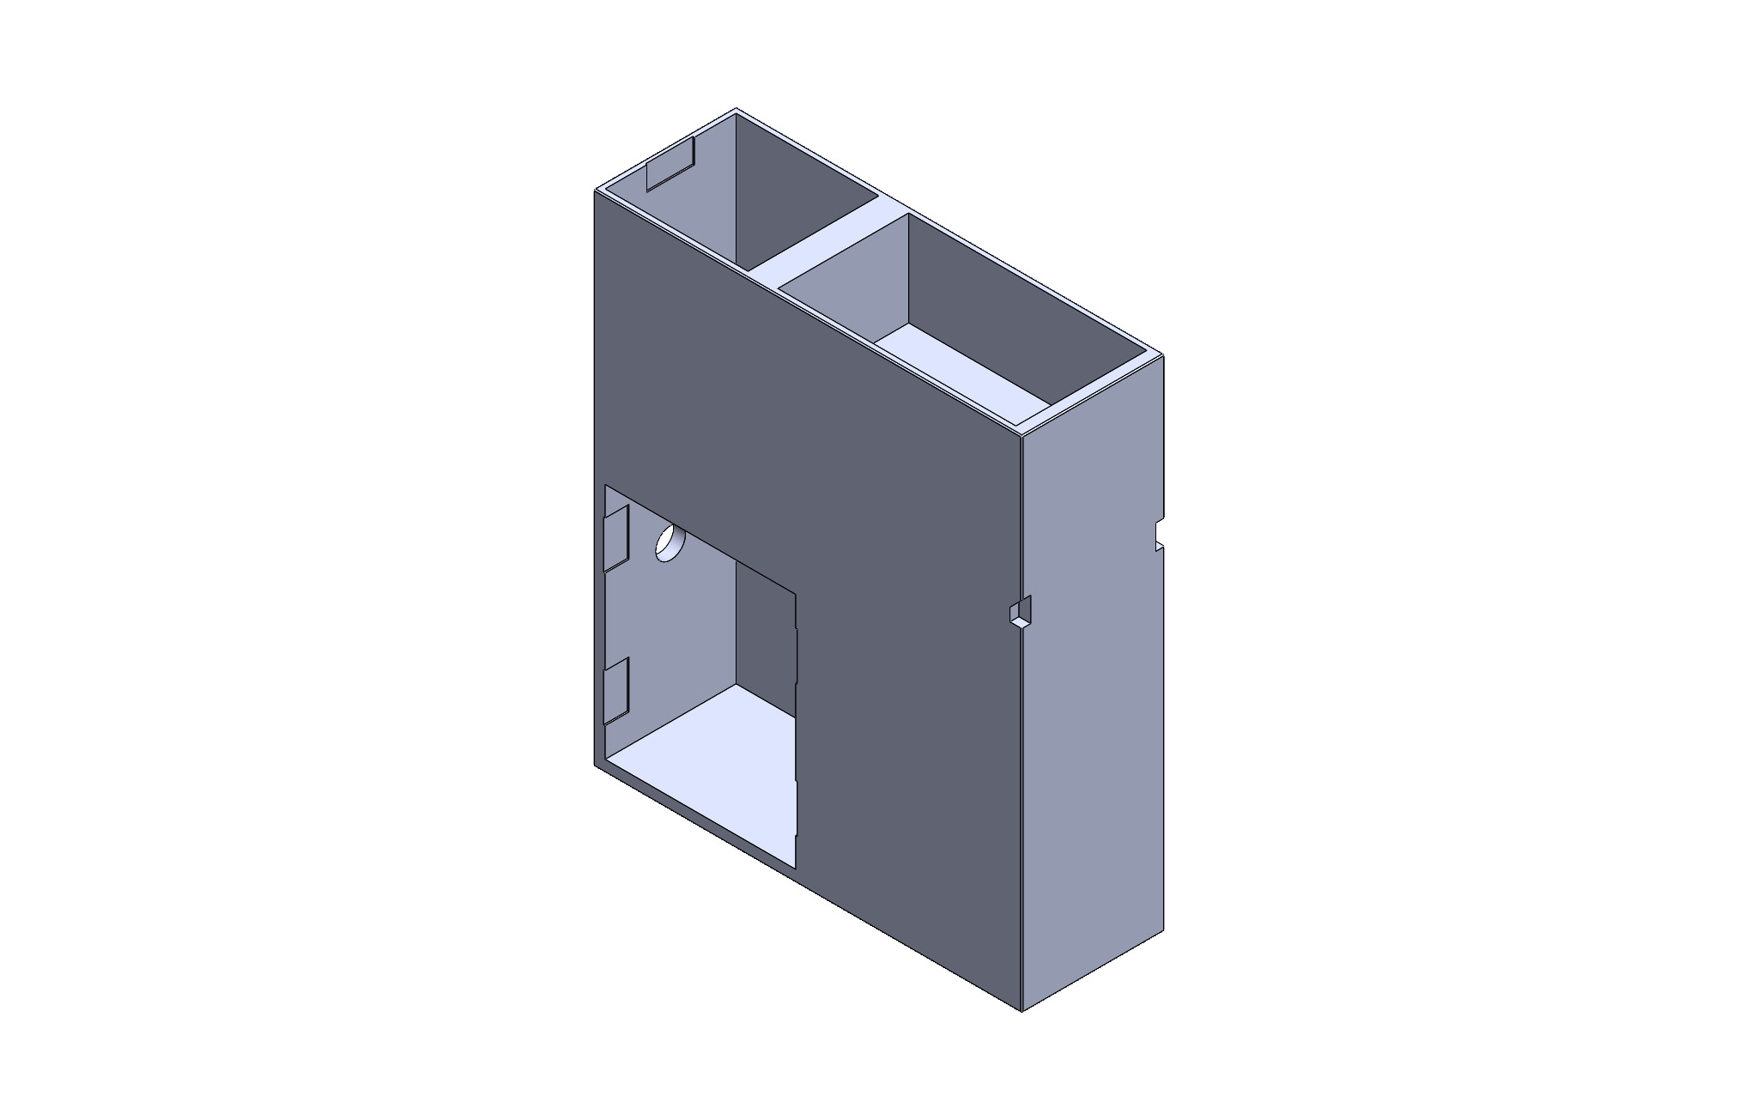
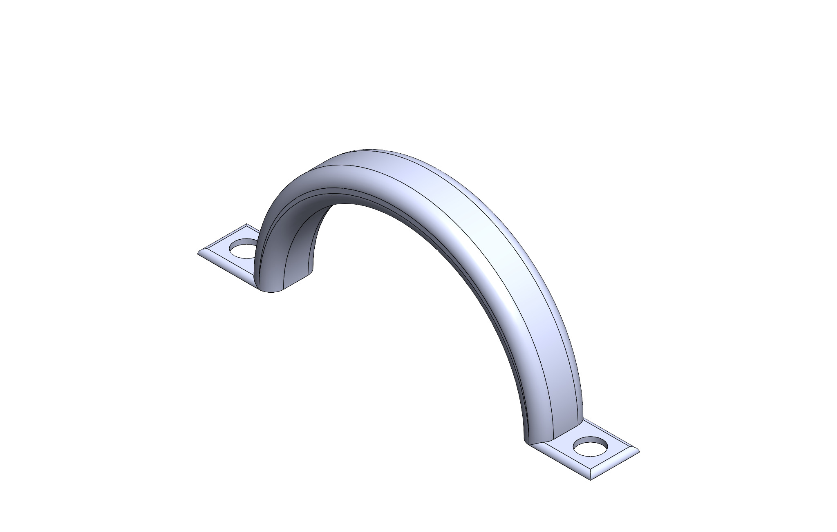
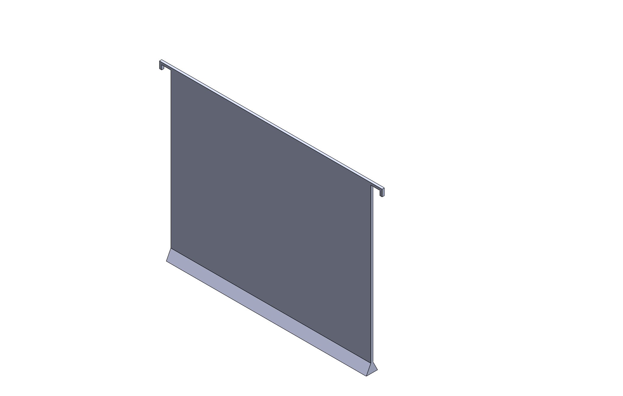
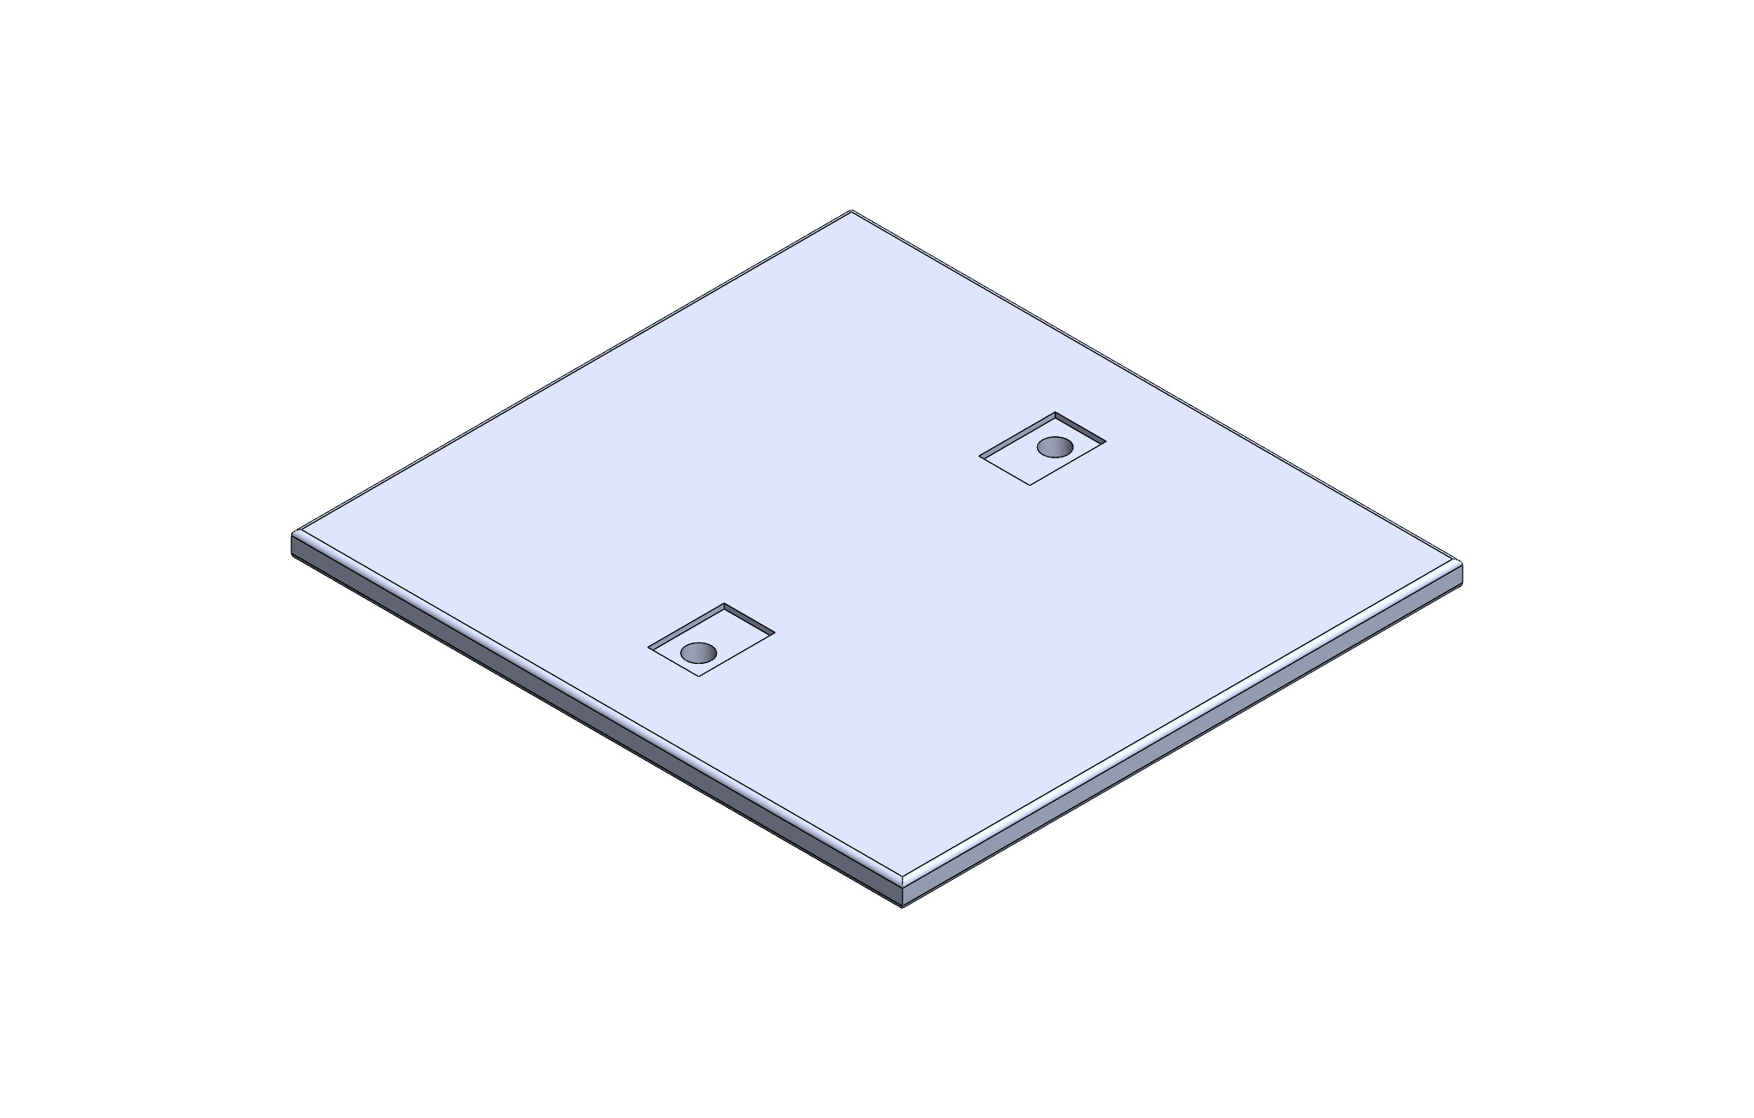
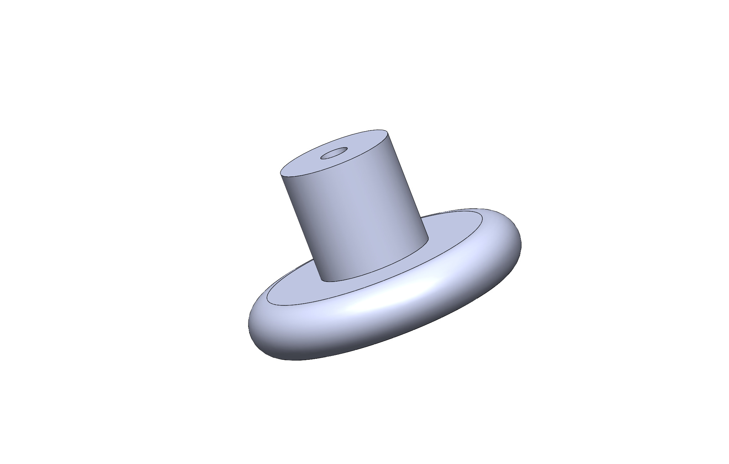
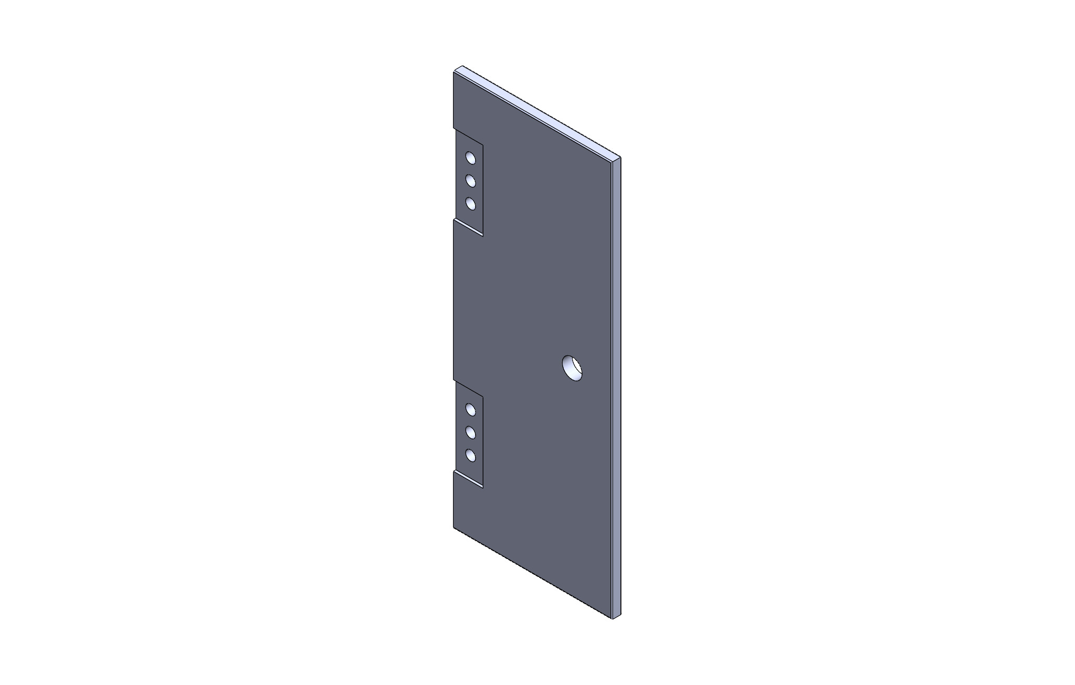
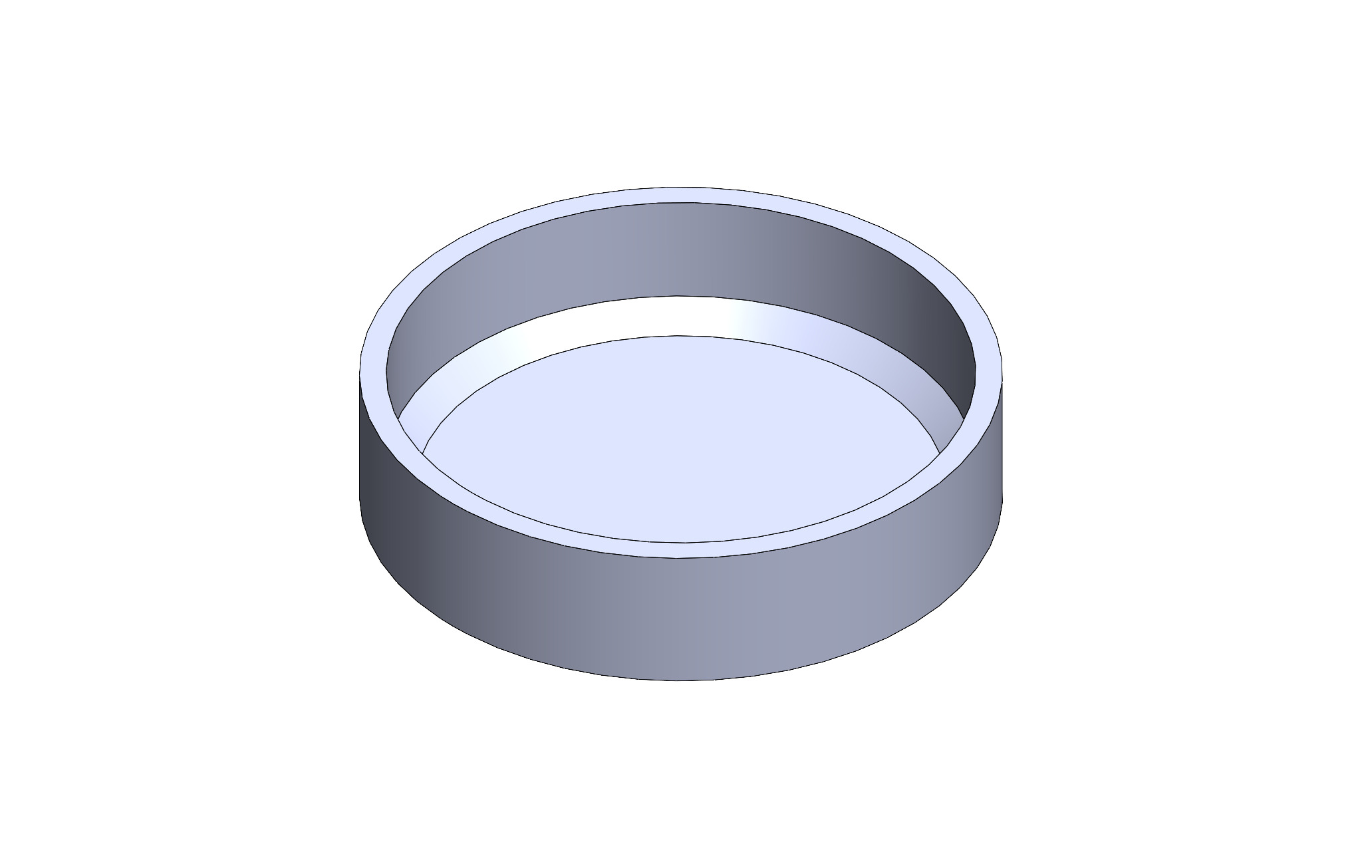
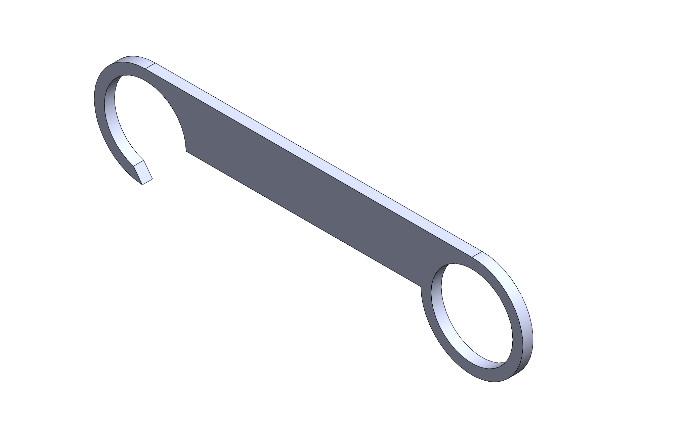
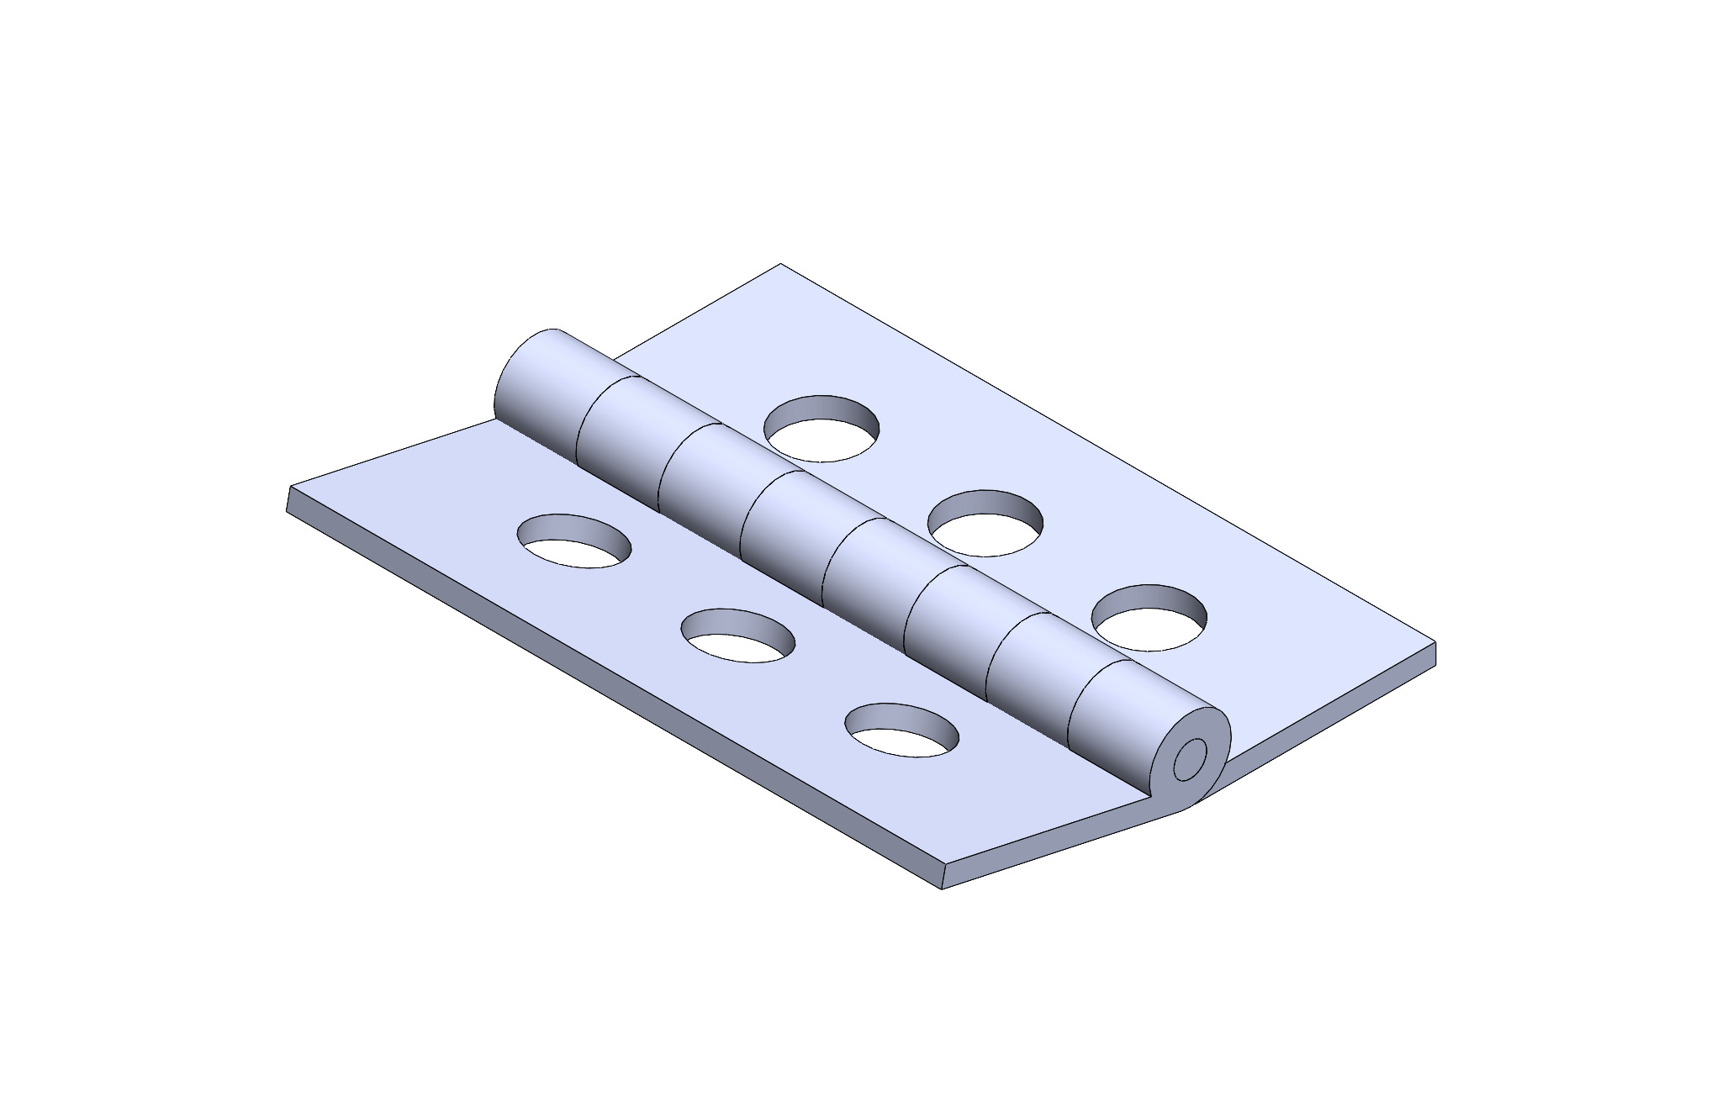
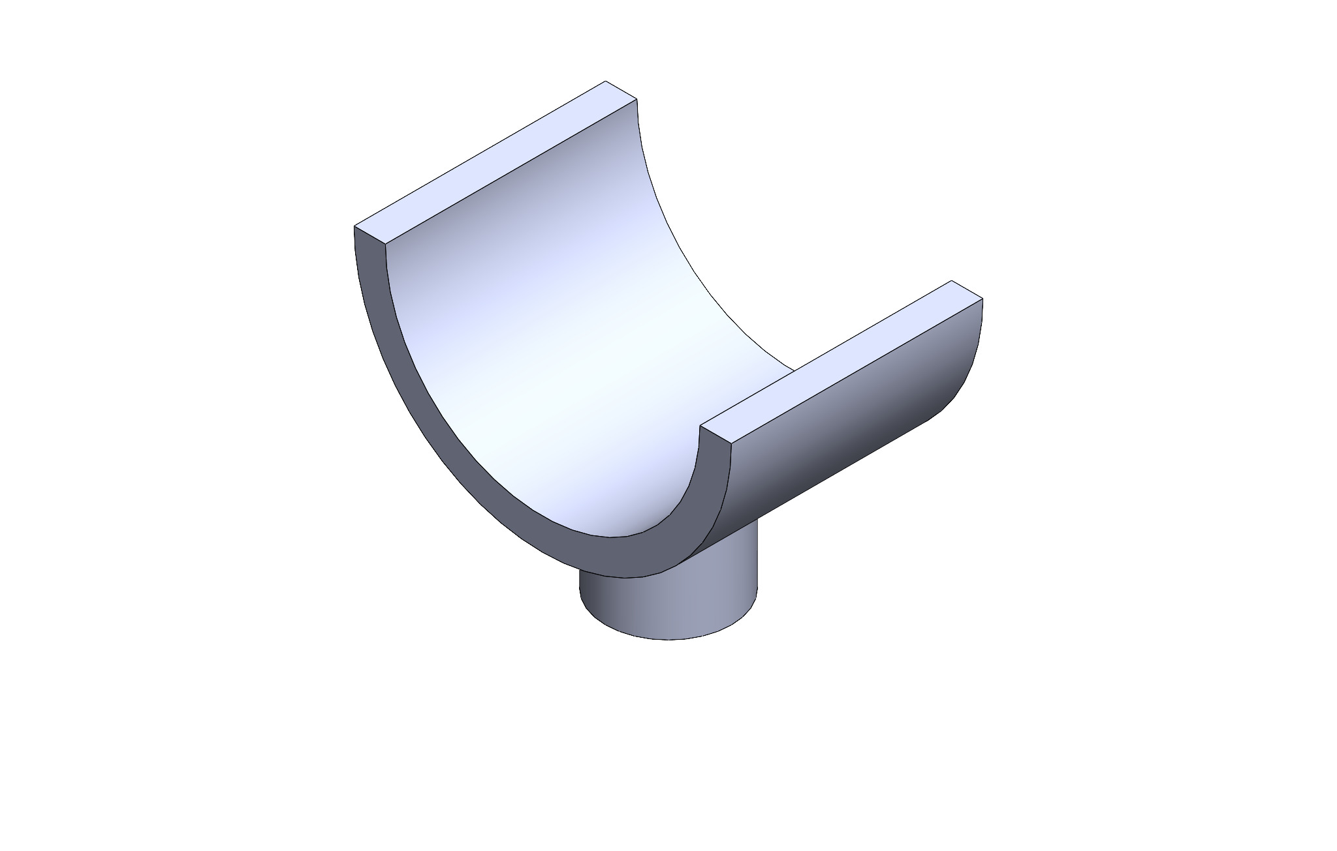
Jackson Foster Parts

Slide 11
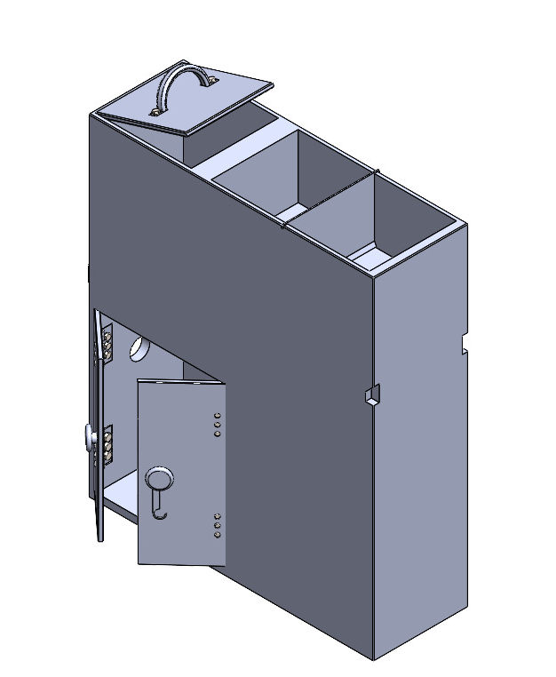
Jackson Foster Sub Assemblies

Slide 12
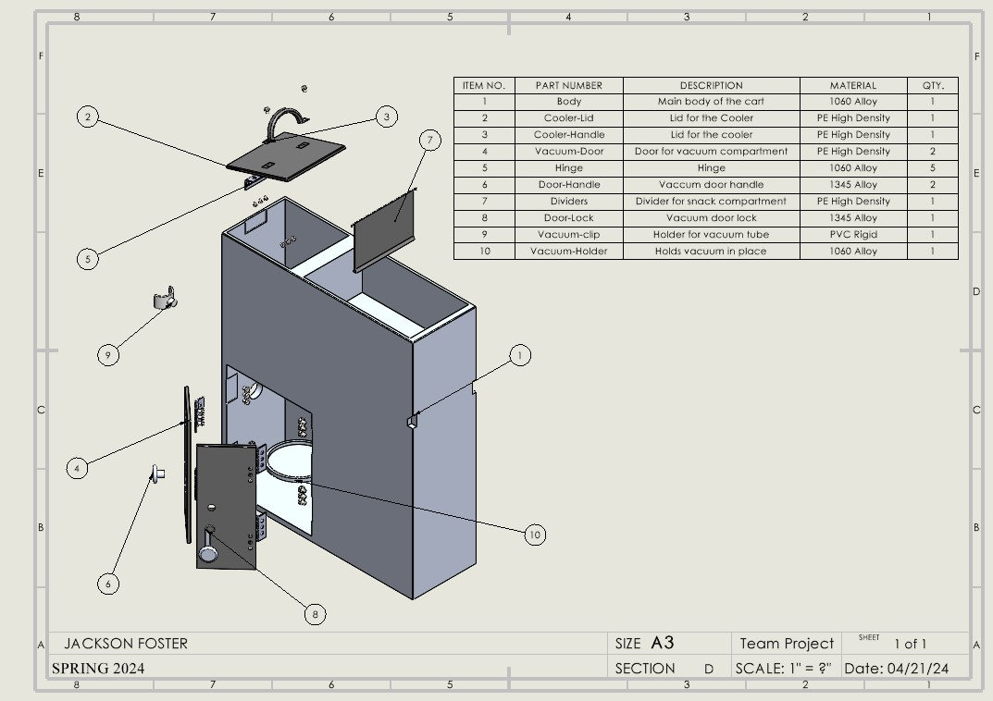
Jackson Foster Exploded Views

Slide 13
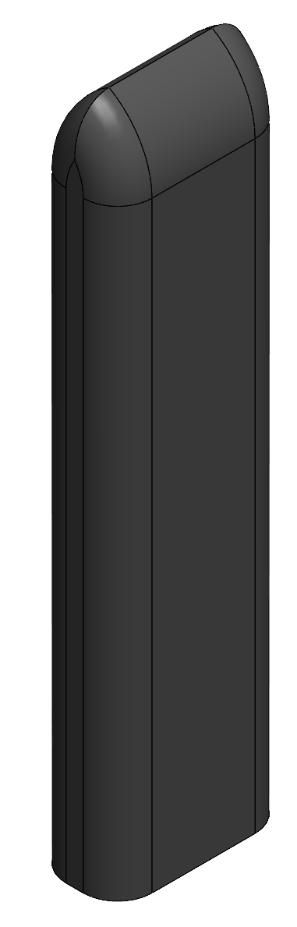
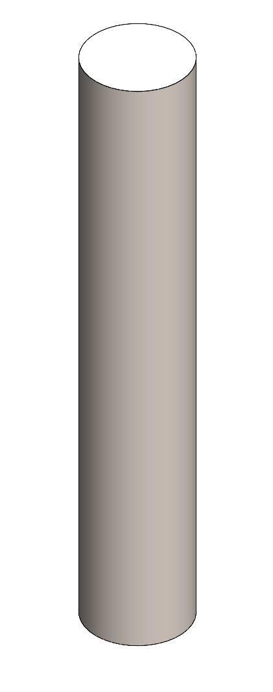
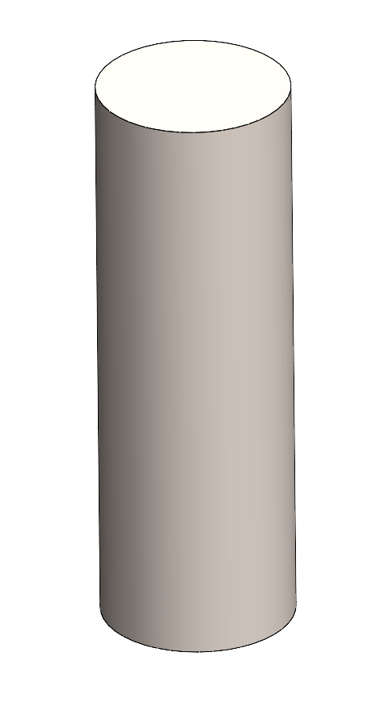
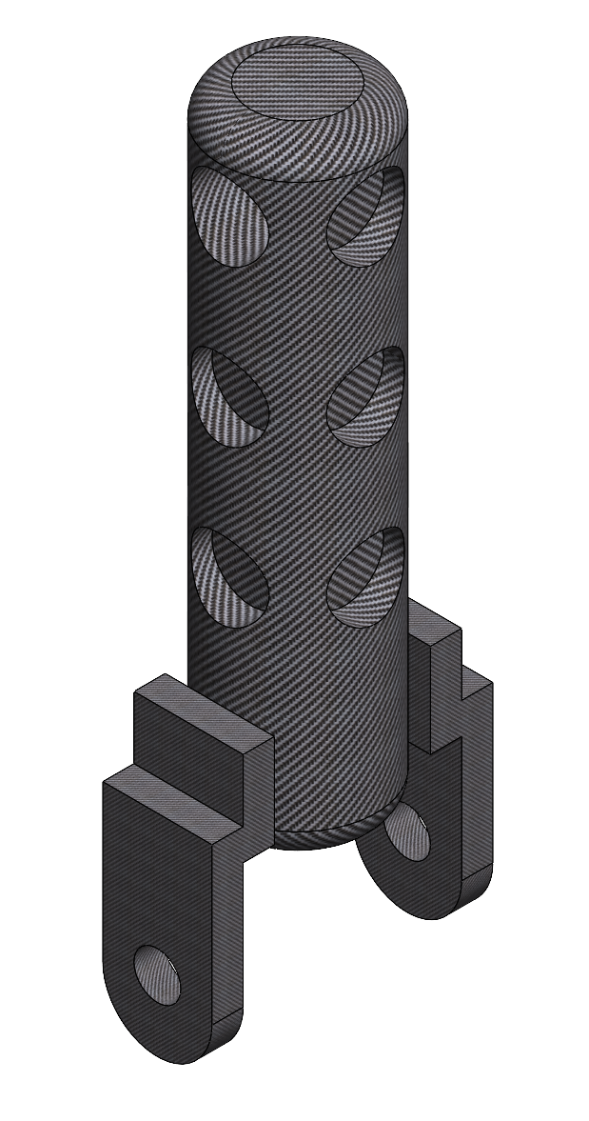
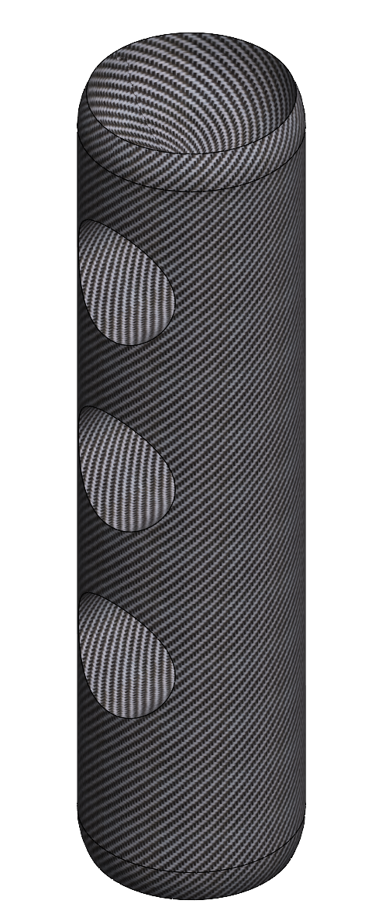
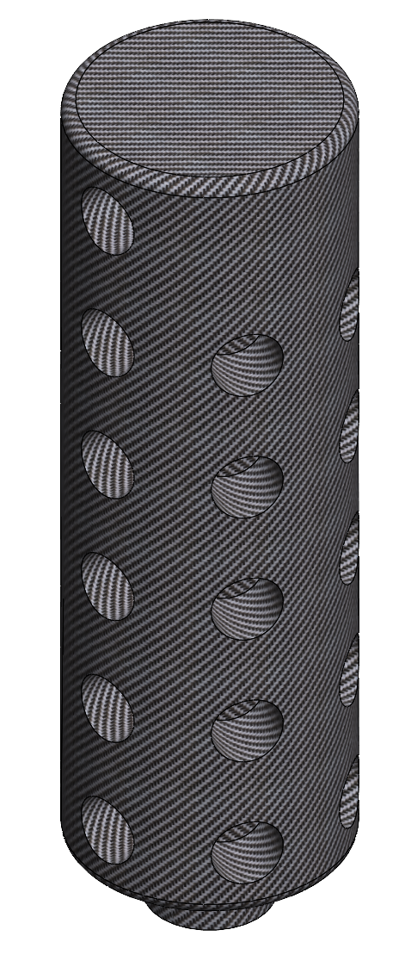
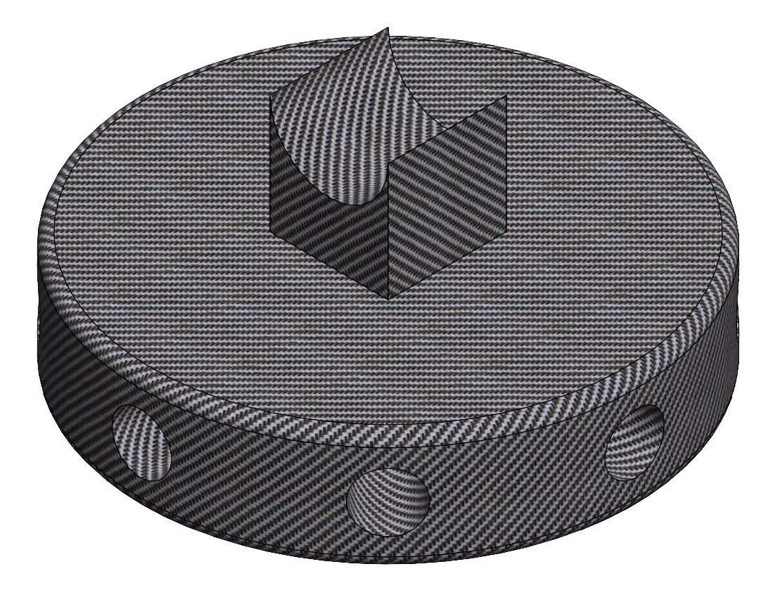
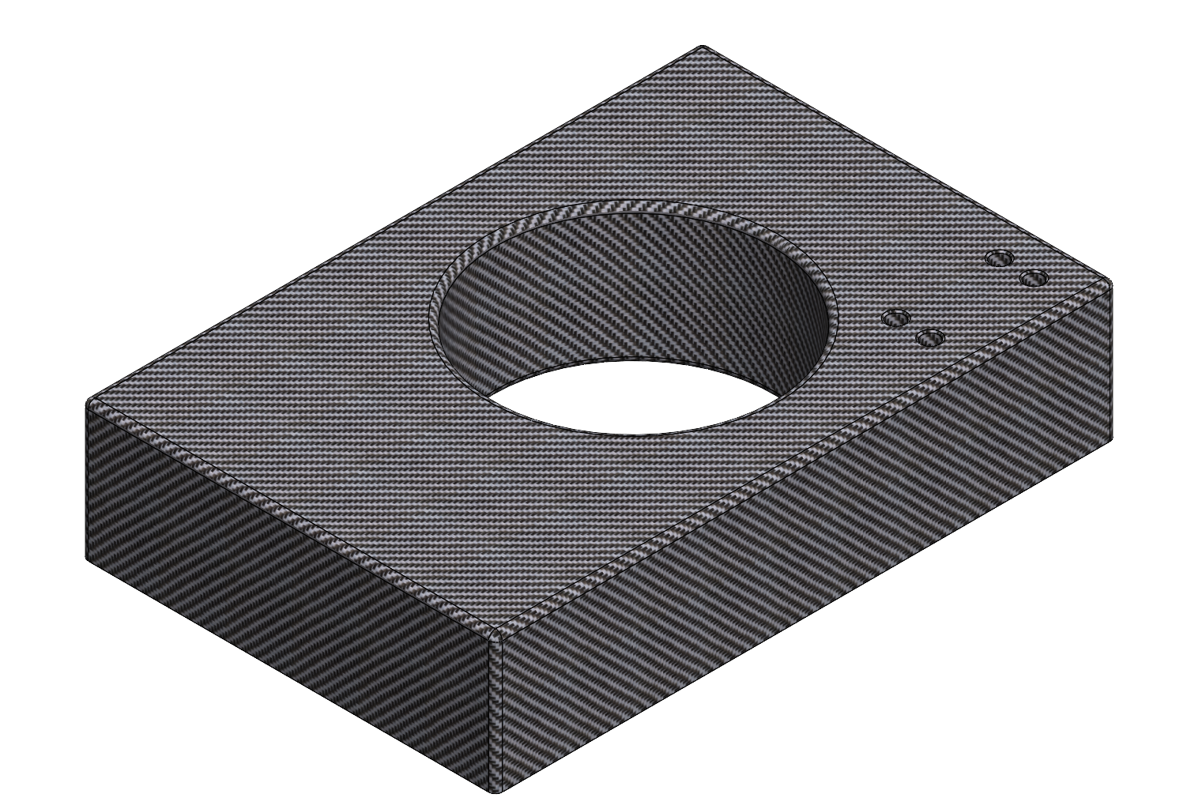
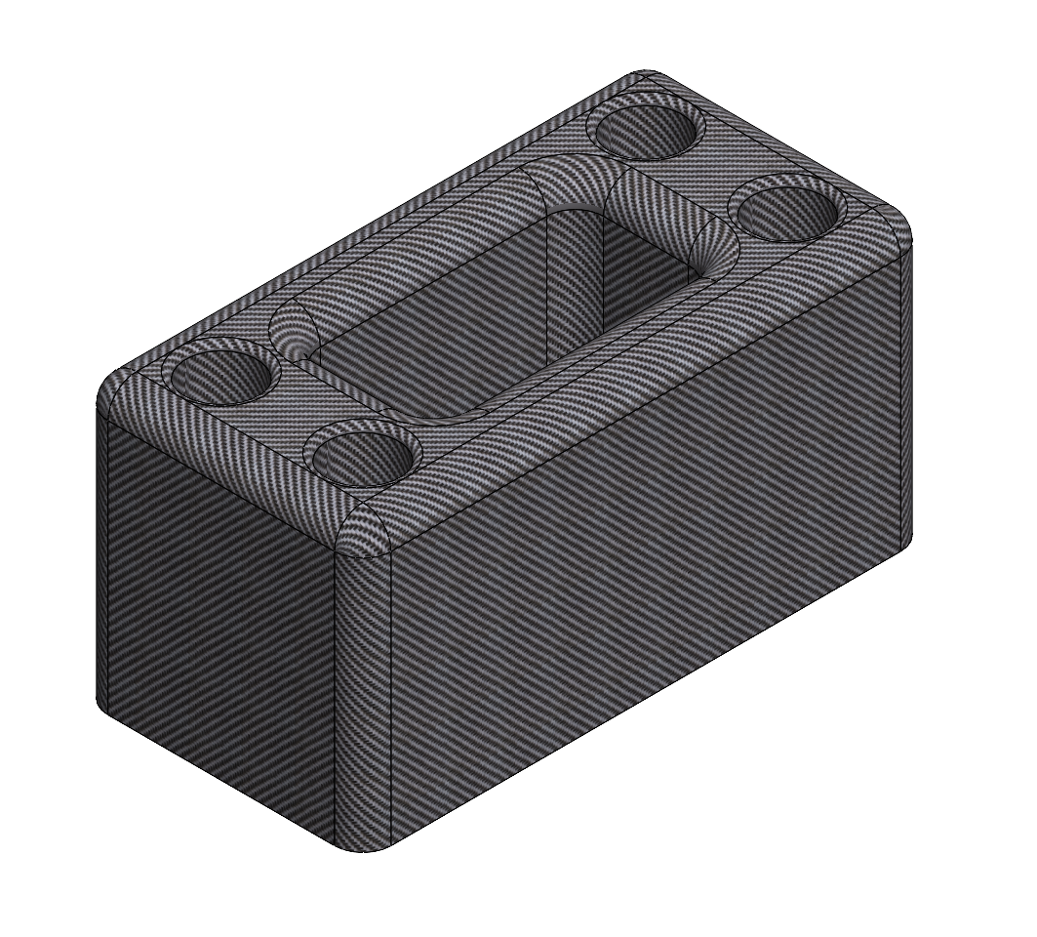
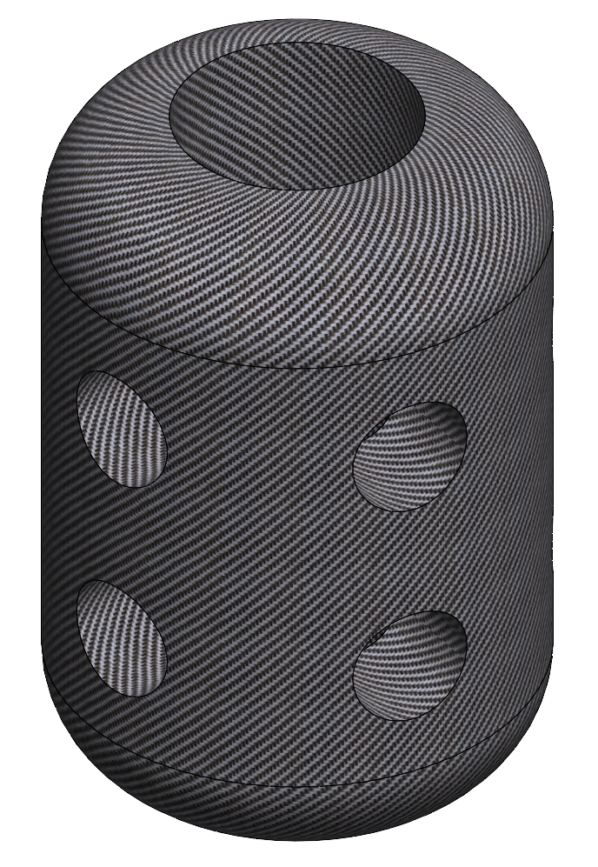

Nishu Anekere Parts

Slide 14

Nishu Anekere Sub-Assemblies

Slide 15

Nishu Anekere Exploded Views

Slide 16










JB O’Neal Parts

Slide 17

JB O’Neal Sub-Assemblies

Slide 18

JB O’Neal Exploded Views

Slide 19
Challenges
Scaling sub-assemblies during the creation of the final assembly
Mating parts/sub-assemblies with multiple degrees of freedom

Slide 20
Rendered Views

Slide 21


Slide 23


Slide 24
Final Animation
https://youtu.be/LSw8MuyeeLE

Slide 25
Conclusions
Team and Individual Projects were a great way to express our interests (ex: Culture aspect of individual project), while also learning CAD Modeling
Enjoyable: Visualizing whole process from ideation to final product
Enjoyable: More than one way to make a 3D Model
Frustrating: Minimum requirements for quantity of part models
Not focused on quality
Learned that designing and manufacturing is not a linear process
Patience is key

Slide 26
Thank You!

